Slide 1
GIT Push and GIT Pull ( Group 8 )
Submitted to:-
Sonu Mehrotra
Submitted By:-
Aanchal Agarwal
Arjun Singh
Dheeraj Mishra
Kuldeep
Shivani Sarthi

Slide 2
CONTENT
Git Push
Git Push Commands
Example of Git Push
Git Pull
Git Pull Commands
Examples of Git Pull
More about Git Push and Git Pull
Why Git Pull is done before Git Push?

Slide 3
GIT PUSH
Git push is used to upload local repository content to a remote repository.It basically is used to publish new local commits on a remote server.
Syntax: git push [options]
Some of the important options for git push are
--all: pushes all local branches
--tags: pushes all the local tags
--delete: deletes the specified branch
--u: creates an upstream tracking connection

Slide 4
SOME GIT PUSH COMMANDS
git push <remote><branch>
Push the mentioned branch to, along with all the necessary commit and internal objects.
git push <remote> --force
This option overrides the “fast forward” restriction and matches our local branch to the remote branch.
git push <remote> --all
The word "all" stands for all branches. It pushes all local branches to the mentioned remote.

Slide 5
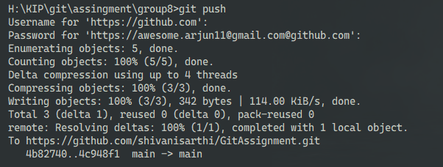
EXAMPLE: GIT PUSH
The git push command sends all of the commits on your local master to the central repository.
git push origin master

Slide 6
GIT PULL
Git pull updates the local branch and also merge the changes from the remote repository to your working directory where updating the local repository means getting the changes from a remote repository to the local repository and updating the local branches with the remote tracking branches.
It basically integrates the new downloaded data from the remote repository into your current working directory.
Also while using git pull there can be cases of merge conflict
git pull is somewhat the addition of git fetch and git merge.

Slide 7
SOME GIT PULL COMMANDS
git pull <remote>
Fetch the specified remote’s copy of the current branch and immediately merge it into the local copy. This is same as git fetch followed by git merge origin.
git pull --no-commit <remote>
Similar to the default invocation, fetches the remote content but does not create a new merge commit.
git pull --rebase <remote>
Same as the previous pull Instead of using git merge to integrate the remote branch with the local one, use git rebase.

Slide 8
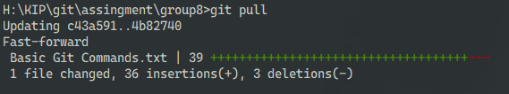
EXAMPLE: GIT PULL
git pull origin

Slide 9
MORE ABOUT GIT PUSH AND GIT PULL
git pull:-
If you make a change in a repository, git pull can allow others to view the changes. It is used to acknowledge the change that you've made to the repository that you're working on. Also called a target repository.
git push:-
The git push command is used to transfer or push the commit, which is made on a local branch in your computer to a remote repository like GitHub

Slide 10
WHY GIT PULL IS DONE BEFORE GIT PUSH ?
As on a particular project, multiple persons/colleagues work at the same time. So, doing pull before push, it will ensure that your local copy of repository will be sync with the remote repository.
As, other people have been pushing to the remote repository, and if you push before syncing up, you could end up with multiple heads or merge conflicts.
That’s why pull is done before push.
Remember the Joke:
“Whenever I see a door that says PUSH, I always PULL first to avoid conflicts.”

Slide 11
THANK YOU
Repository Link:-
https://github.com/shivanisarthi/GitAssignment.git

